Slide 1
Voyage Estimation
CARGOSPOTTER

Slide 2
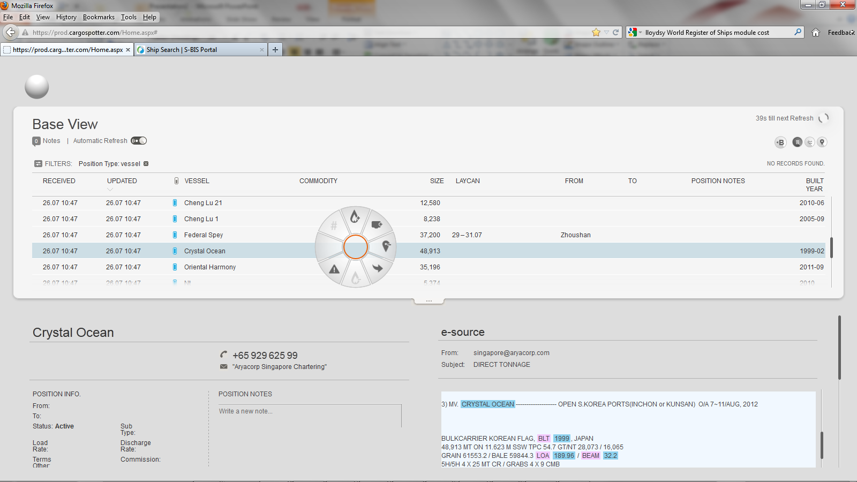
In Position right click to open wheel to go to Voyage Estimator
VE

Slide 3
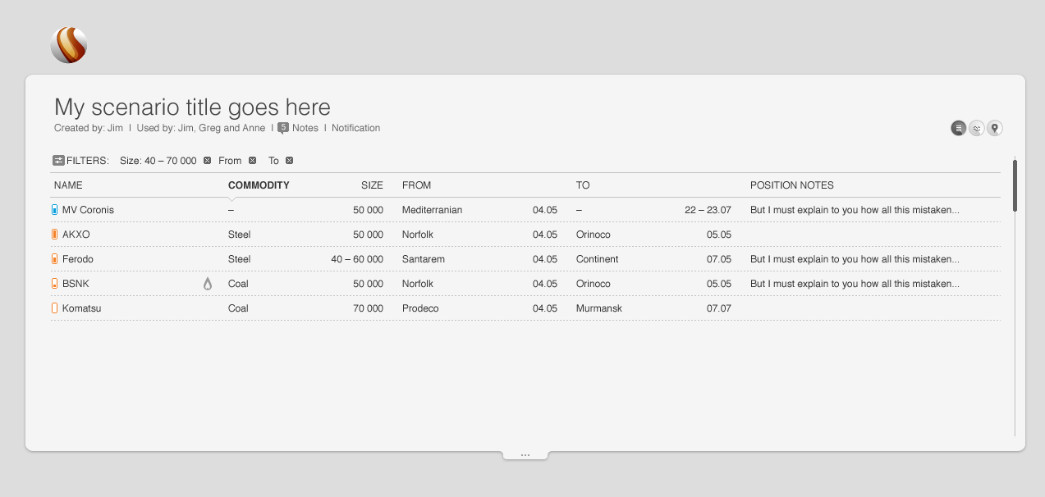
So Feeds are
S-BIS ships data
Veson
Bunkersworld
Voyage Estimator
Estimated Freight
$
Per MT
Commission
%
Vessel Name
Crystal Ocean
DWT
34000
Ship Name
View full ships details
Fuel | Speed | MT IFO | Sea MDO | Port MDO
Loaded | 13.5 | 25 | 1.5 | 1
Ballast | 14 | 21 | 0 | 0
LS 380 | LS 180
 | 13.5
 | 14
Bunker Port Name
Cost/Mt |  | 900 | 950 | 1050 950 875
Live Bunker Pricing
Cost/Mt |  | 900 | 950 | 1050 950 875
Cargo Stowage Factor | COAL | Bale | Gr Intake | Bl Intake | DWCC | Used
1 | 55,000 | 0 | 55,000 | 0 | 54,274 | 73,372
Ports |  | Distance | Steam Days | Port Days | Port Costs | FO Sea | MDO Sea | MDO Port LSO 380 LS180 | Total Fuels
Ballast port | B | 1725 | 5.13
Load Port | L | 0 | 0.00 | 1.81 | $15,000 | 0.00 | 0.00 | 1.81 0.00 0.00 | 0.00
Laden | Laden | 2,281 | 7.04 | 0 | $120,000 | 176.00 | 10.56 | 0.00 0.00 0.00 | 0.00
Discharge | D | 0 | 0.00 | 1.55 | $45,000 | 0.00 | 0.00 | 1.55 0.00 0.00 | 0.00
Extra Steaming |  | 0 | 0.00 |  |  | 0.00 | 0.00 | 0.00 0.00 0.00 | 0.00
Totals |  | 4006 | 12.17 | 3.36 | $180,000 | 176.00 | 10.56 | 3.36 0.00 0.00 | 13.92
DWCC Calculation |  |  |  |  | IFO Costs | $158,403 |  | MDO Costs | $13,224 | LSO 380 LSO 180
Deadweight | 55,000 | MT |  |  | Reserve | 100 | MT |  | 35 | MT
Less FO Consumption | 276 | MT |  |  | Cons+Reserve | 276.00 | MT |  | 48.92 | MT
Less MDO | 100 | MT |  |  | ROB | 500 | MT |  | 100 | MT
Less FW | 100 | MT |  | Qtty to use | For DWCC | 276.00 | MT |  | 100 | MT
Less Constant | 250 | MT
Less Reserve / Extra Steaming | 0 | MT |  | Dem | Desp

Slide 4
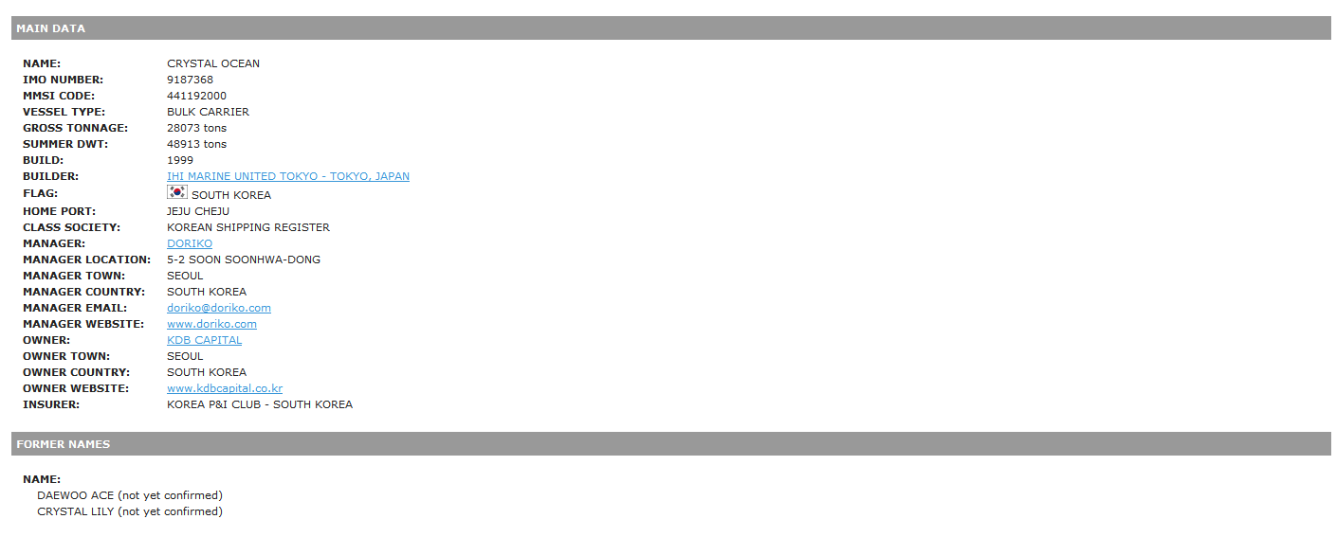
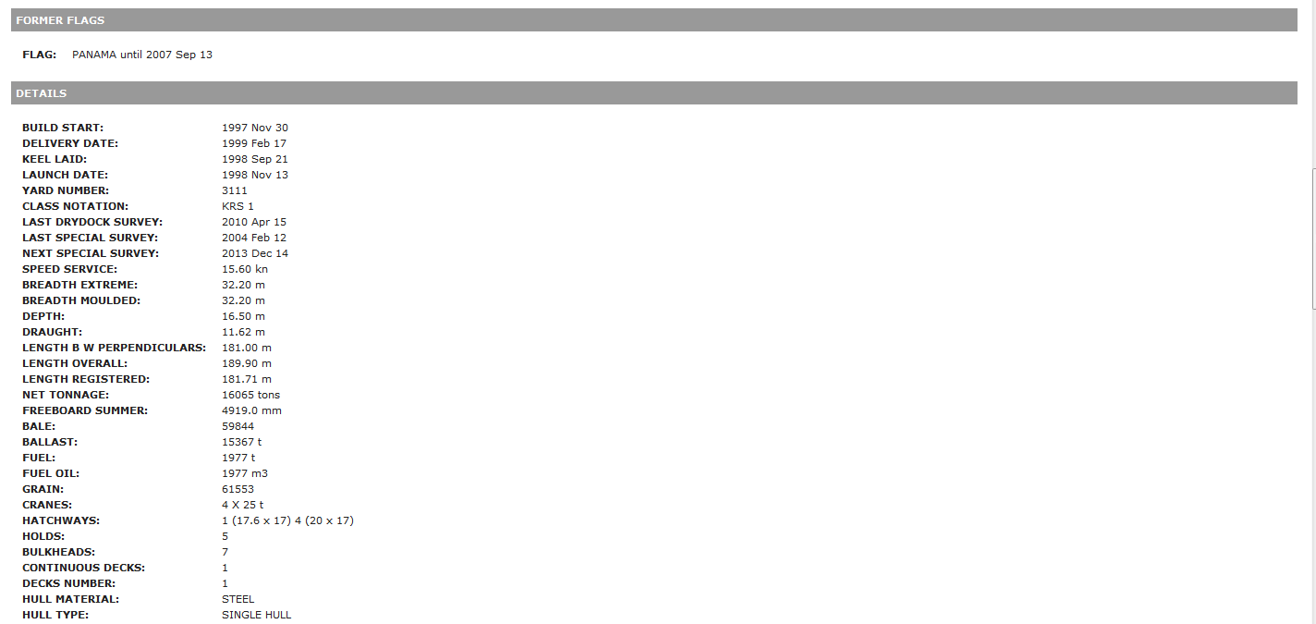
FLAG: | PANAMA until 2007 Sep 13

Slide 5
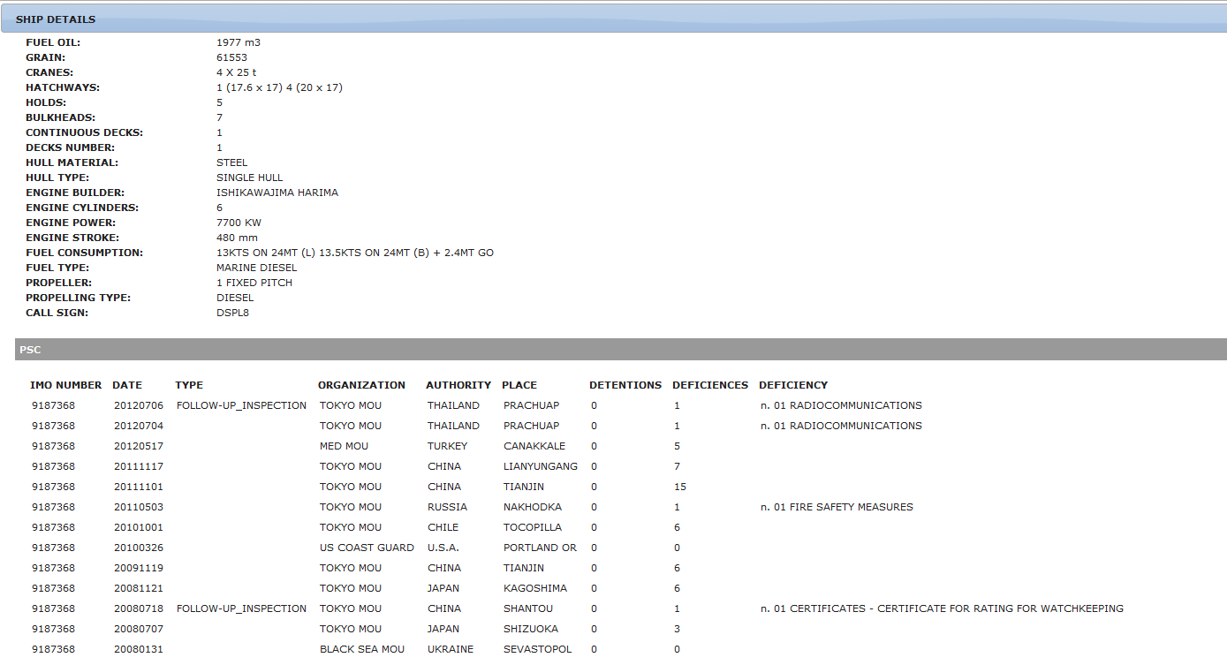

Slide 6
